Slide 1

PREDICTION OF DIABETES
EXPOSYS DATA LABS
Project by
SHOBHAN AKSHAY GIRIDHARAN SNEHA JAYWANT SABLE
SAMUEL WILLIAM ROBERT DHANRAJ JAYA SHETTY

Slide 2

AGENDA
Abstract
Types of Diabetes
Introduction
Diabetes Infographics
Flowchart for predicting diabetes using Machine Learning
Dataset Description
Data Exploration and Visualization
Library and IDE used in the Project
Conclusion

Slide 3
ABSTRACT
Diabetes is an illness caused because of high glucose level in a human body. Diabetes should not be ignored, if it is untreated then Diabetes may cause some major issues in a person like: heart related problems, kidney problem, blood pressure, eye damage and it can also affects other organs of human body.
Diabetes can be controlled if it is predicted earlier. But with the growth of machine learning methods we have got the flexibility to do early prediction of Diabetes in a human body or a patient for a higher accuracy through applying, Various Machine Learning Techniques.
Machine learning techniques Provide better result for prediction by constructing models from datasets collected from patients. In this work we will use Machine Learning Classification and ensemble techniques on a dataset to predict diabetes. Which are XG Boost (XGB), Decision Tree (DT), Support Vector Machine (SVM) and Random Forest (RF).
The accuracy is different for every model when compared to other models. The Project work gives the accurate or higher accuracy model shows that the model is capable of predicting diabetes effectively. Our Result shows that Random Forest achieved higher accuracy compared to other machine learning techniques.

Slide 4
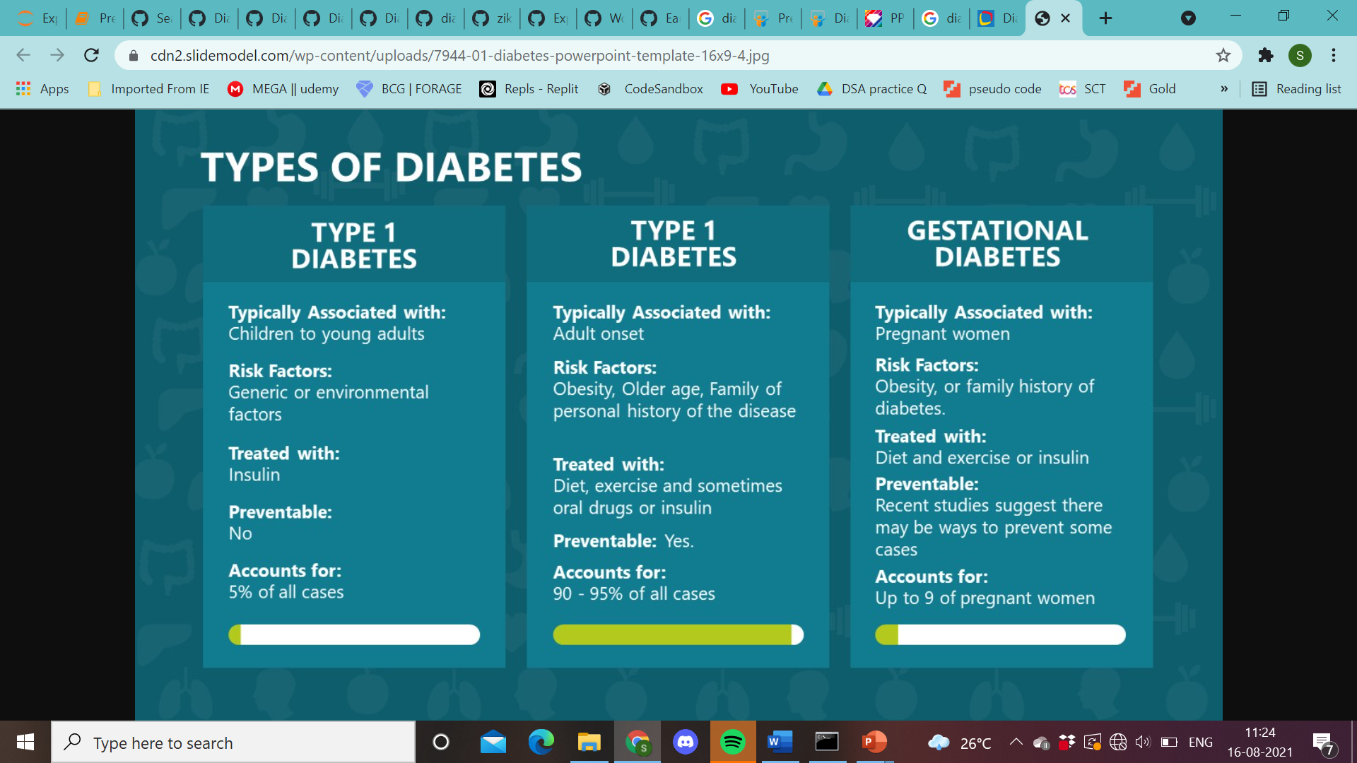
TYPES OF DIABETES
2

Slide 5
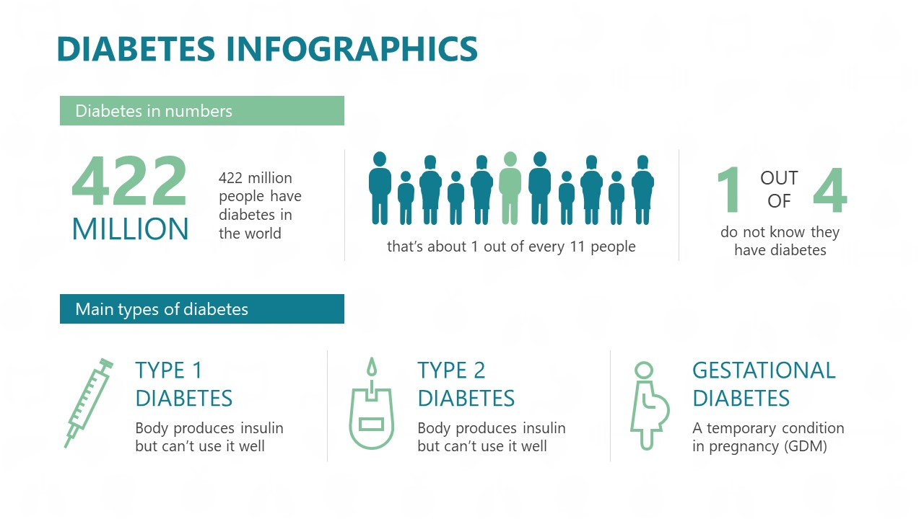
DIABETES INFOGRAPHICS

Slide 6
INTRODUCTION
Around 400 million people suffer from diabetes around the world. Diabetes prediction is challenging as it involves complex interactions or interdependencies between various human organs like eye, kidney, heart, etc.
The machine learning (ML) algorithms provide an efficient way of predicting the diabetes. The objective of this work is to build a system using ML techniques for the accurate forecast of diabetes in a patient. The decision tree (DT) algorithms are well suited for this.
In this work, we have applied the DT algorithm to forecast type 2 diabetes mellitus (T2DM). Extensive experiments were performed on the Pima Indian Diabetes Dataset (PIDD) obtained from Kaggle. Based on the results, we observed that the decision tree was able to forecast accurately when compared to the SVM algorithm on the diabetes data. Other models such as Random Forest Classifier(RFC), XGBoost (XGB) were used which resulted to best accuracy for prediction of diabetes.

Slide 7
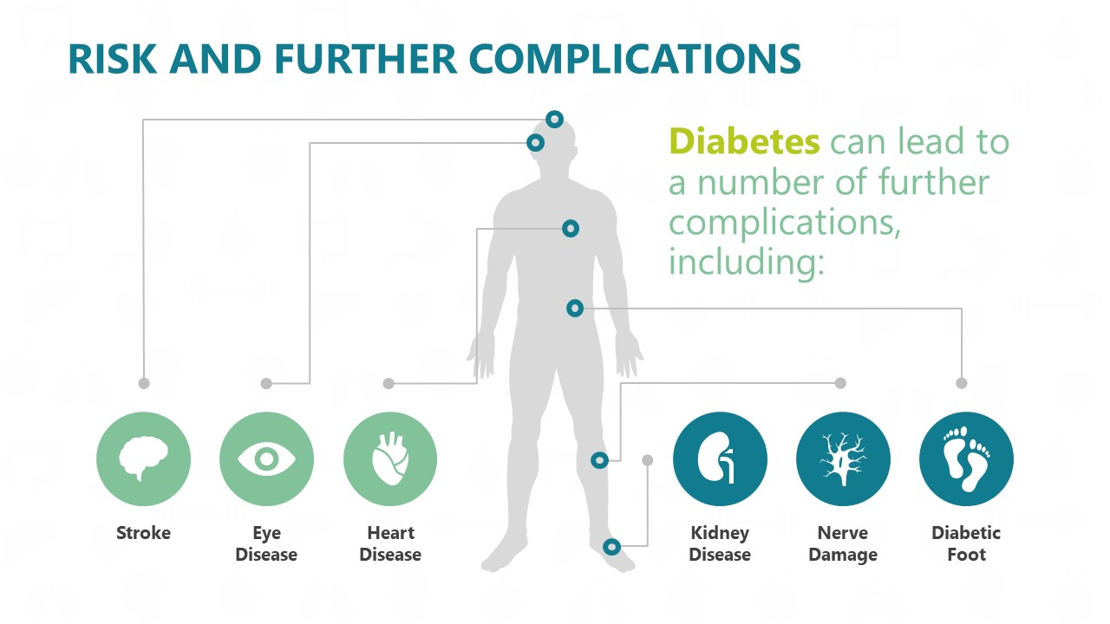
RISK FACTOR AND FURTHER COMPLICATIONS

Slide 8
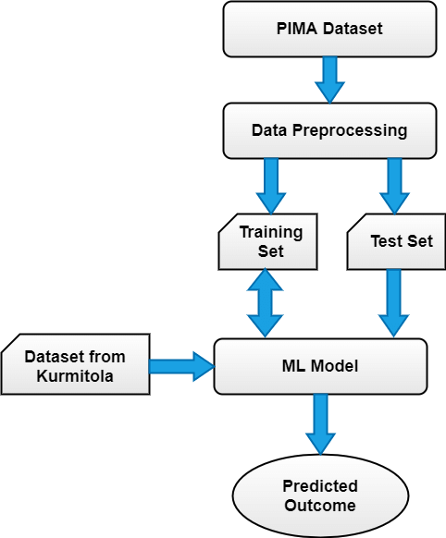
FLOWCHART FOR PREDICTING DIABETES USING MACHINE LEARNING

Slide 9
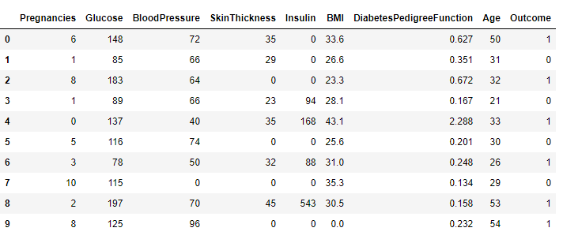
THE DATA IS GATHERED FROM UCI REPOSITORY WHICH IS NAMED AS PIMA INDIAN DIABETES DATASET. THE DATASET HAVE MANY ATTRIBUTES OF 768 PATIENTS.
Dataset Description

Slide 10
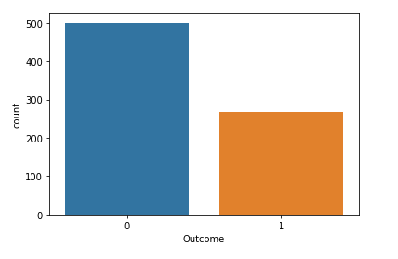
RATIO OF DIABETIC AND NON-DIABETIC PATIENT

Slide 11
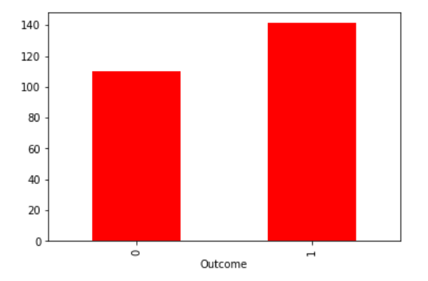
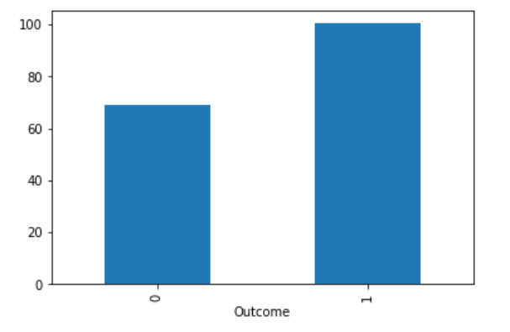
DATA EXPLORATION AND VISUALIZATION
Glucose
Insulin

Slide 12
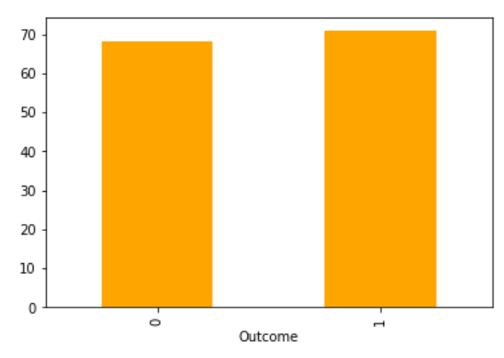
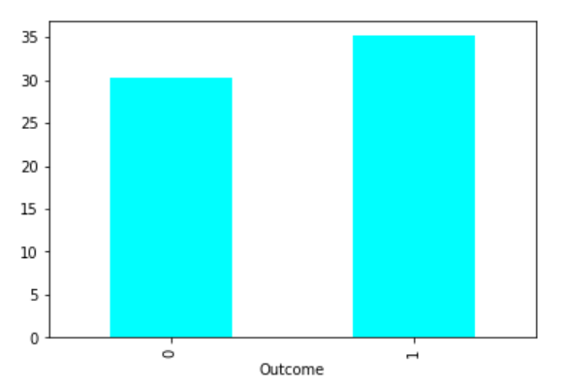
DATA EXPLORATION AND VISUALIZATION
Blood Pressure
BMI

Slide 13
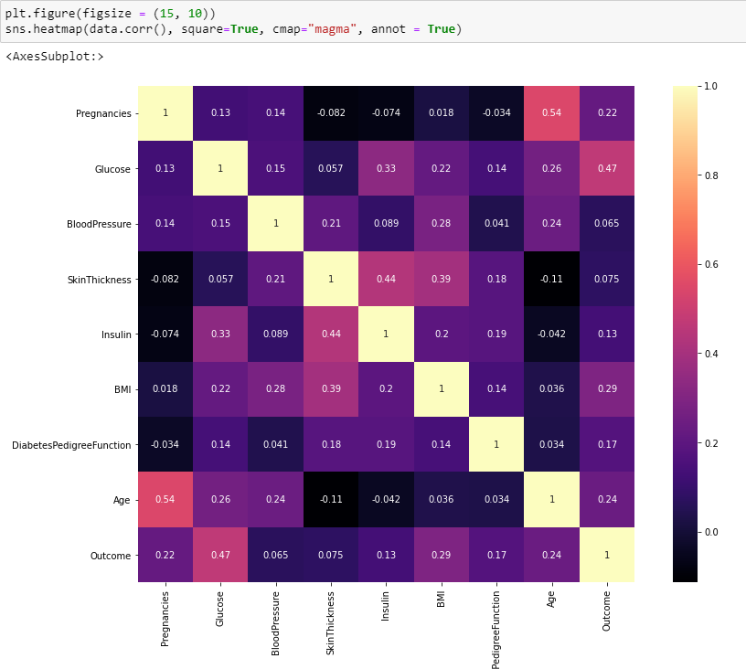
HEATMAP OF CORRELATED DATA

Slide 14
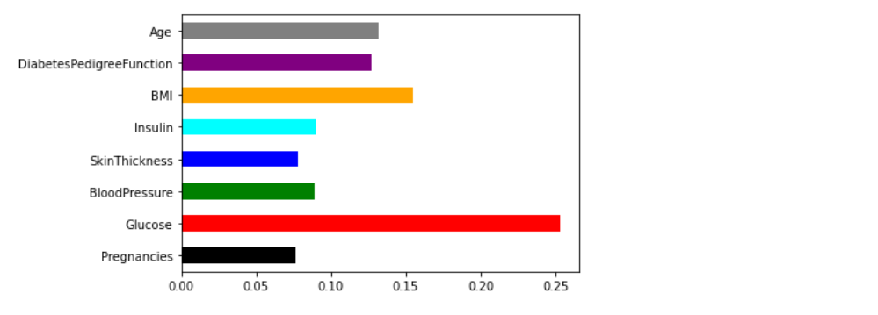
DIABETES PREDICTION OF GLUCOSE & BMI
The graph shows the most important feature in this diabetes prediction is glucose & BMI.

Slide 15
LIBRARY AND IDE USED IN THE PROJECT
Pandas
NumPy
Seaborn
Matplotlib
Sci-kit learning
IDE Used for compiling:- Jupyter Notebook (Python)

Slide 16
CONCLUSION
The main aim of this project was to design and implement Diabetes Prediction Using Machine Learning Methods and Performance Analysis of that methods and it has been achieved successfully. The proposed approach uses various classification and ensemble learning method in which SVM, XGBoost, Random Forest, Decision Tree classifiers are used. Random Forest Classifier is the best model for this prediction since it has an accuracy score of 75.98% .
The Experimental results can be assisted health care to take early prediction and make early decision to cure diabetes and save humans life.

